Slide 1
2 milestone KMAP
Webpage for Real estate - Farm properties, auctions and visitor ads

Slide 2
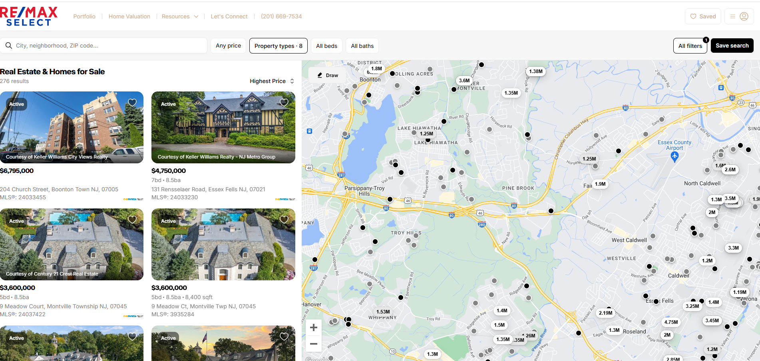

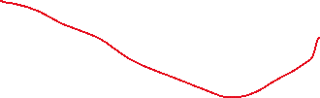
Interactive MAP
Like we said similar like booking or same like I sent you in first message.
Pleas try and completely copie this type of map – for me looks THE BEST!!!!.
https://michaelgabrielrealtor.com/
On upper webpage Go to HOME SEARCH page
same like this map with my logo pins ( 3map pins different color 1.for admin ads 2. for auction 3. for user ads)
And filters of this map looks great to!

Slide 3




RENT, BUY, ALL
Togle button : Buletin board, court auction, user ads

Slide 4
Adding Ads – 3 different adds
Ads added by admin (from buletin board)
Court Auction
Ads added by user

Slide 5
Ads added by Admin (just admin or user added by admin) ADS from bulletin boards
1.Name of the ad
2. administrative unit- in attacment i will send you list of all administrative unit, if you can implement this document, will be great
3. cadastral number and name – in attacment i will send you list of all cadastral number, if you can implement this document, will be great. (for ad need to be possible to add more cadastral number in one ad)
4.Region (here will be 6options :1, Osrednjeslovenska, 2.Gorenjska,3. Goriška z obalno kraško, 4. Podravska in pomurje, 5. JZ Slovenija s primorsko-notranjsko, 6.Posavska,Zasavska,Savinjska in Koroška)
4.1Plot number ( here is possible to add more plot numbers – and for all, should be added more map pins, but it's all one ad)
4.2.Type of the land for each Plot number(check box : meadow, field, forest, building land, building on land,garden, other)
4.3 on lease YES/NO for each plot number
4.4 Share in real estate in % for each plot number
4.5.Size in m2 for each plot number
5. package sale YES/NO if they choose NO then Price need to be able to add for each Plot number if YES then will be just one price
6.Price / Price for m2
7.Notes
8.Location ( pin on map/ address/ cordinates) (possible all three options)
9.Details of owner
11.Date of publication
12.Date of expiration (with next day need ads automaticly be removed)
13.BUY/RENT
TYPE OF BUILDING ( apartment/house/weekend house/ farm/ office/ warehouse/garage/other)
13.LINK : Place where I can paste direct link to this sale

Slide 6
Auction Ads
1.Name of the ad
2. administrative unit - in attacment i will send you list of all administrative unit, if you can implement this document, will be great
3. cadastral number and name – in attacment i will send you list of all cadastral number, if you can implement this document, will be great. (for ad need to be possible to add more cadastral number in one ad)
4.Region (here will be 6options :1, Osrednjeslovenska, 2.Gorenjska,3. Goriška z obalno kraško, 4. Podravska in pomurje, 5. JZ Slovenija s primorsko-notranjsko, 6.Posavska,Zasavska,Savinjska in Koroška)
4.1Plot number ( here is possible to add more plot numbers – and for all, should be added more map pins, but it's all one ad)
4.2Type of auction subject for each Plot number(check box : meadow, field, forest, building land, building on land,, building,garden, apartment, commercial property,other)
4.3. Share in real estate for each plot nimber
4.4 Size in m2 for each plot number
package sale YES/NO
Starting price (EUR)
Security deposit amount (EUR)
Notes
TYPE OF BUILDING ( apartment/house/weekend house/ farm/ office/ warehouse/garage/other)
Year built
Location address ( pin on map/ address/ cordinates)
Check box: Traditional sales / Online sales / Public tendering
sales method: Check box: Auction with increasing price,Commission sale,Sale with non-binding collection of offers,Sale with binding collection of offers
Date of publication
Date of auction (with next day need ads automaticly be removed)
.Name of the sales location, Address of the sales location, Auction space
Auction sequence number
Attachments ( here i will put some pdf and docx document with informations about auctions)
Admin need to check and approve each auctions added by users.

Slide 7
Ads added by user
1.Name of the ad
2. administrative unit- in attacment i will send you list of all administrative unit, if you can implement this document, will be great
3. cadastral number and name – in attacment i will send you list of all cadastral number, if you can implement this document, will be great. (for ad need to be possible to add more cadastral number and administrative unit in one ad)
4.Region (here will be 6options :1, Osrednjeslovenska, 2.Gorenjska,3. Goriška z obalno kraško, 4. Podravska in pomurje, 5. JZ Slovenija s primorsko-notranjsko, 6.Posavska,Zasavska,Savinjska in Koroška)
4.1Plot number ( here is possible to add more plot numbers – and for all, should be added more map pins, but it's all one ad)
4.2.Type of the land for each Plot number(check box : meadow, field, forest, building land, building on land,building,garden, apartment, commercial property,other)
4.3 on lease YES/NO for each plot number
4.4 Share in real estate in % for each plot number
4.5.Size in m2 for each plot number
5. package sale YES/NO if they choose NO then Price need to be able to add for each Plot number if YES then will be just one price
6.Price / Price for m2
7.Notes
8.Location ( pin on map/ address/ cordinates)
9.details of owner
10-TYPE OF BUILDING ( apartment/house/weekend house/ farm/ office/ warehouse/garage/other)
Year built
11. Contact of owner- telephone (need to be) ,mail (optional)
12.Date of publication
13.Date of expiration 1 month (admin can manage time of ads) (with next day need ads automaticly be removed or send mail to user if they want to prolonged)
14. BUY/RENT
Admin need to check and approve each ads added by users.

Slide 8
Search filters
Checkbox : (Admin ads)buletin board ads, Court Auctions, Users ads
Checkbox : Type of the land: meadow, field, forest, building land, building on land,other, building, apartment,house, commercial property, other
Checkbox :BUY/RENT
Option to chose from the list administrative unit and all Slovenia (they can chose more of them) – You have list in attachments
Option to chose from the list cadastral number with name and all cadastral number.(they can chose more of them) – You have list in attachments
Minimum maximum Size in m2 land
Minimum maximum Size in m2 building/apartment
Minimum maximum price
Minimum maximum Share in real estate
Auction part : - Check box: Traditional sales / Online sales / Public tendering
Check box: Auction with increasing price,Commission sale,Sale with non-binding collection of offers,Sale with binding collection of offers
Auction sequence number 1,2,3,4,5,6,7
Auction Date from … to … , next week , next month
For all checkbox, need to be option ALL
IF you will se some other filter options, pleas just add.

Slide 9
Subscription message on next slide

Slide 10
Subject: Thank You for Your Subscription to KMap.si!
Dear [User's Name],
Thank you for subscribing to KMap.si! Your subscription is now active, and you can start exploring exclusive features that will help you find the perfect agricultural land, auctions, and real estate opportunities with precise locations on our interactive map.
Your Subscription Details:
Plan: [Selected Plan]
Duration: [Monthly/Yearly]
Start Date: [Start Date]
Renewal Date: [Renewal Date]
What’s Next?
✔ Access to our interactive real estate map with detailed property locations. ✔ Customized Alerts – Get notified about new listings and auctions based on your preferences. ✔ Early Access to Exclusive Listings before they appear on public platforms.
You can manage your subscription and preferences anytime in your user dashboard: ➡ Login to Your Account (button)
If you have any questions, feel free to contact us at [Your Support Email].
Thank you for choosing KMap.si – your trusted partner in finding the right land and real estate opportunities!
Best regards, The KMap.si Team [Your Website URL]
My LOGO

